Slide 1
Warm-Up – 8/29 – 10 minutes
Utilizing your notes and past knowledge answer the following questions:
What invention led to the eventual development of rockets?
According to legend, who attempted to fly to the moon?
This inventors manuscripts contained the first drawings of helicopters.
What flammable gas was discovered by Cavendish?

Slide 2
Questions / Comments

Slide 3
Warm-Up – 8/29 – 10 minutes
Utilizing your notes and past knowledge answer the following questions:
What invention led to the eventual development of rockets?
According to legend, who attempted to fly to the moon?
This inventors manuscripts contained the first drawings of helicopters.
What flammable gas was discovered by Cavendish?

Slide 4
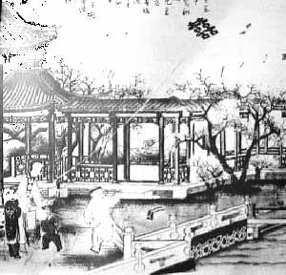
Legends About Flight
Chinese built the first devices to enable us to fly
About 100 BC – they invented the kite
Some large enough to carry a man and they used them to watch enemy troops in the 17th Century
About 900 AD – invented gunpowder
1100 AD used gunpowder to power rockets
Used in celebrations and warfare

Slide 5
Warm-Up – 8/29 – 10 minutes
Utilizing your notes and past knowledge answer the following questions:
What invention led to the eventual development of rockets?
According to legend, who attempted to fly to the moon?
This inventors manuscripts contained the first drawings of helicopters.
What flammable gas was discovered by Cavendish?

Slide 6
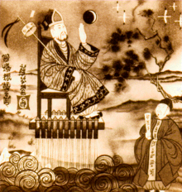
Legends of Flight
Chinese legend of manned flight using a rocket
Wan Hoo attempted to fly to the moon
Large wicker chair with 47 large rockets
When ignited Wan Hoo disappeared in large ball of smoke and fire - never to be seen again
Chinese legend –Wan Hoo is the man in the Moon!

Slide 7
Warm-Up – 8/29 – 10 minutes
Utilizing your notes and past knowledge answer the following questions:
What invention led to the eventual development of rockets?
According to legend, who attempted to fly to the moon?
This inventors manuscripts contained the first drawings of helicopters.
What flammable gas was discovered by Cavendish?

Slide 8
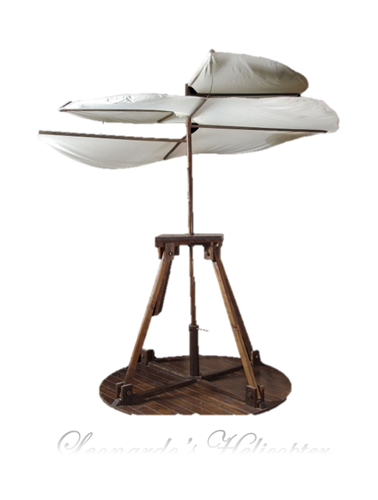
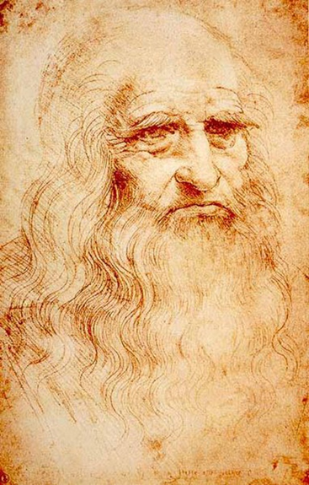
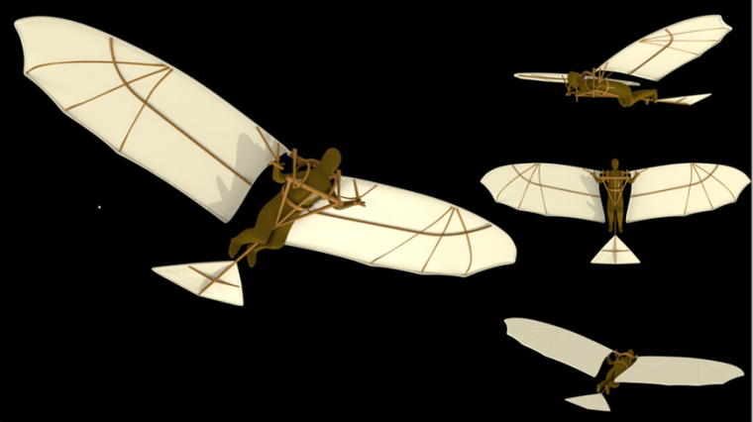
Early Scientific Research
Leonardo da Vinci (1452 – 1519)
Great Italian artist, architect, man of science
Left descriptions and sketches of flying machines
(first known designs of parachute and helicopter)
Died in 1519 manuscripts not found until 300 years later
Might have changed history – if found earlier

Slide 9
Warm-Up – 8/29 – 10 minutes
Utilizing your notes and past knowledge answer the following questions:
What invention led to the eventual development of rockets?
According to legend, who attempted to fly to the moon?
This inventors manuscripts contained the first drawings of helicopters.
What flammable gas was discovered by Henry Cavendish?

Slide 10
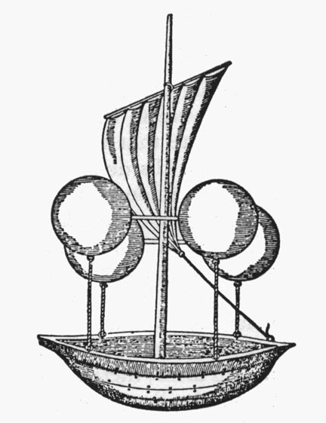
Basic Scientific Research
English chemist Henry Cavendish discovered “flammable air” – hydrogen (lighter than air)

Slide 11
Questions / Comments

Slide 12
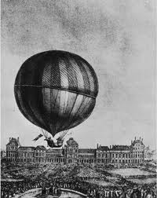
THIS DAY IN AVIATION
August 29
1879 — In Ontario, Nellie Thurston becomes the first Canadian woman to fly in a balloon.

Slide 13
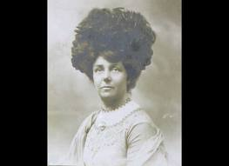
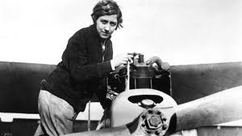
THIS DAY IN AVIATION
August 29
1911 — Mrs. A. Hewlett is the first British woman to gain a pilot's license.

Slide 14
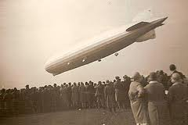
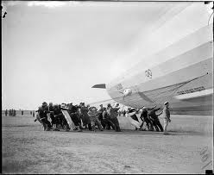
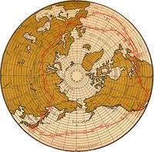
THIS DAY IN AVIATION
August 29
1929 — “Graf Zeppelin” lands at Lakehurst, New Jersey, completing round-the-world flight, begun on 8 August.
The distance flown was 20,000 miles in 21 days 7 hours.
The actual flying time was 263 hours 43 minutes.

Slide 15
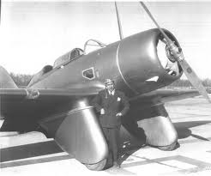
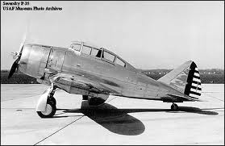
THIS DAY IN AVIATION
August 29
1938 — Flying from New York to Los Angeles, Major Alexander de Seversky makes an east-west transcontinental speed record flight of 10 hours 3 minutes.
The aircraft flown was a Seversky “Pursuit” powered by a Pratt & Whitney “ Twin Wasp” engine.

Slide 16
Questions / Comments

Slide 17
August 2017
Sunday | Monday | Tuesday | Wednesday | Thursday | Friday | Saturday
 |  | 1 | 2 | 3 | 4 | 5
6 | 7 | 8 | 9 | 10 | 11 | 12
13 | 14 | 15 | 16 | 17 Welcome to Aviation | 18 Flightline Friday | 19
20 | 21 NO SCHOOL | 22 Parts of an Aircraft Forces of Flight Syllabus Due | 23 Flight Control Surfaces | 24 Aircraft Review | 25 Flight Line Friday Quiz | 26
27 | 28 Chapter 1 Intro to Aviation | 29 Chapter 1 Intro to Aviation | 30 Chapter 1 Intro to Aviation | 31 Chapter 1 Intro to Aviation | 1 Flightline Friday Test | 2
3 | 4 HOLIDAY | 5 | 6

Slide 18
Questions / Comments

Slide 19
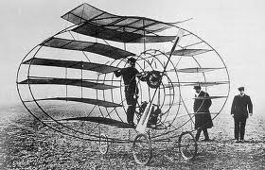
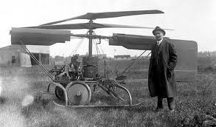
Early
Flying
Machines

Slide 20
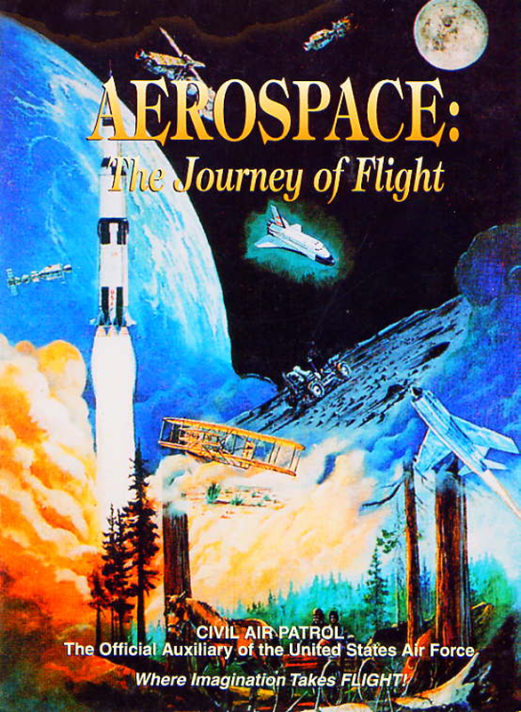
Chapter 1
Introduction to Air Power

Slide 21
Today’s Mission Requirements
Mission:
Identify the significant contributions that advanced air and space power.
Identify the individuals with the contributions they made to developing the airplane.
EQ:
Describe some of the innovations that led to advances in air and space power.

Slide 22
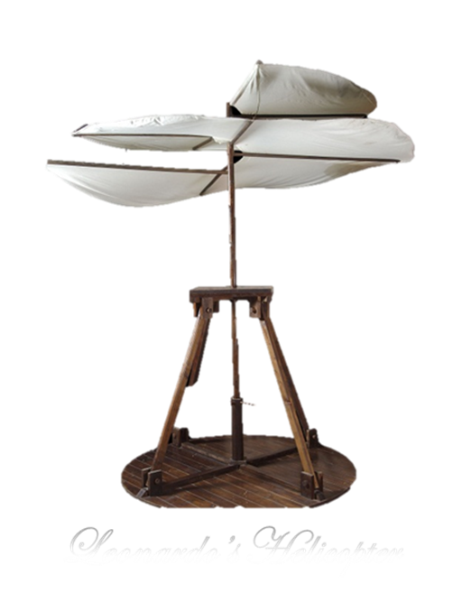
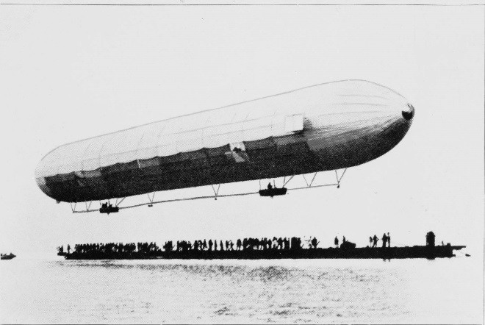
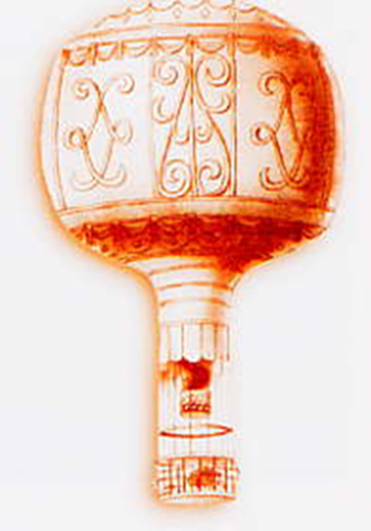
Developing the Airplane
Aviation Pioneers struggled with:
developing lift
sustaining lift
and controlling aircraft

Slide 23
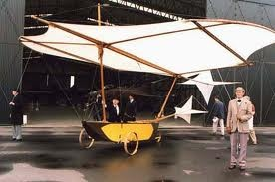
Developing the Airplane
Sir George Cayley was the 1st 19th century airplane pioneer
Built and flew small model gliders
Laid foundation for modern aeronautics with published account of making a surface support a given weight by the application of power to the resistance of air
He identified the forces of lift, drag, and thrust
Built 1st successful full-sized, manned glider

Slide 24
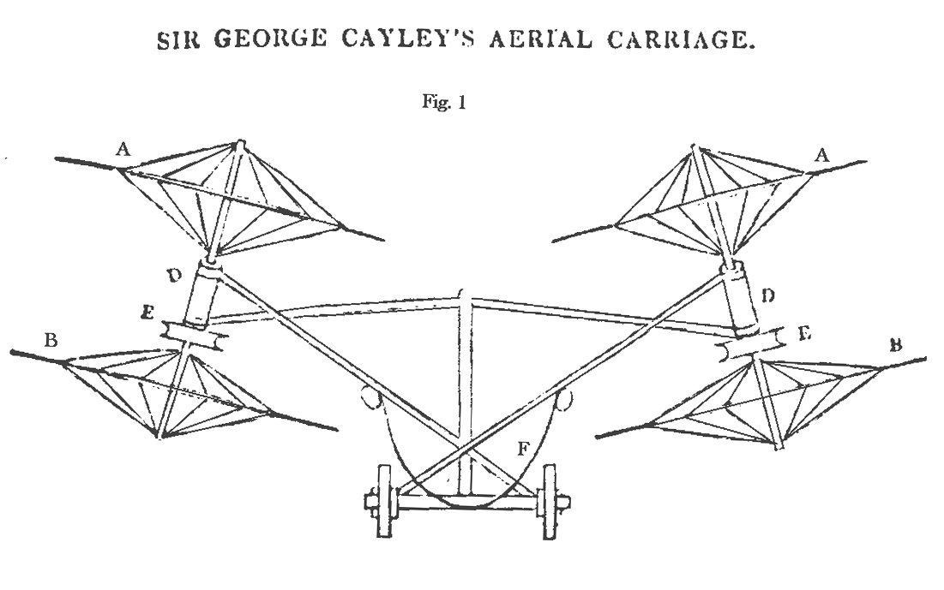

Slide 25
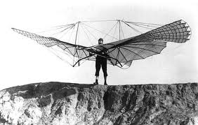
Developing the Airplane
Otto Lilienthal – Father of Modern Aviation
He built single-winged and two-winged gliders
1891-1896, he made over 2,000 glides some over 700 ft
Built an engine to link the wingtips
Built a pilot control system
Wrote a book on aviation and spurred interest around the world

Slide 26
Developing the Airplane
Octave Chanute
Read Lilienthal’s works and improved upon them
Designed gliders but was too old to fly them
Known for his study of aviation history and collection and distribution of aviation information

Slide 27
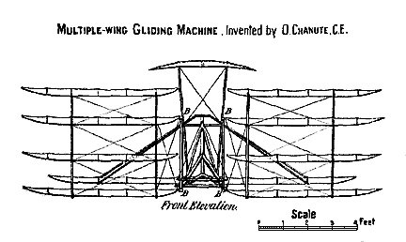
Octave Chanute

Slide 28
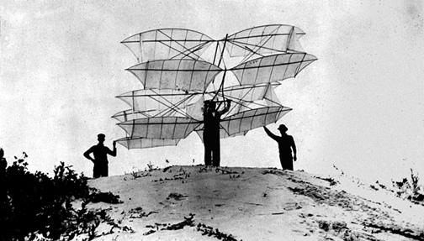
Octave Chanute

Slide 29
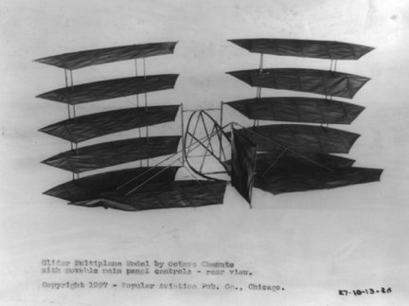
Octave Chanute

Slide 30
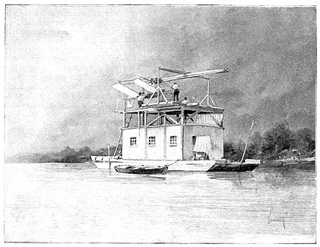
Developing the Airplane
Samuel Pierpont Langley attempted to add power to a glider
1903, the Aerodrome launched by a catapult from a barge anchored in the Potomac River
It fell into the river.
Same thing happened on the next attempt two months later
Both attempts widely covered by the press – the U.S. government dropped its support and Langley gave up project

Slide 31
Questions / Comments

Slide 32
Today’s Mission Requirements
Mission:
Identify the significant contributions that advanced air and space power.
Identify the individuals with the contributions they made to developing the airplane.
EQ:
Describe some of the innovations that led to advances in air and space power.

Slide 33
Developing the Airplane
Sir George Cayley was the 1st 19th century airplane pioneer
Built and flew small model gliders
Laid foundation for modern aeronautics with published account of making a surface support a given weight by the application of power to the resistance of air
He identified the forces of lift, drag, and thrust
Built 1st successful full-sized, manned glider

Slide 34
Developing the Airplane
Otto Lilienthal – Father of Modern Aviation
He built single-winged and two-winged gliders
1891-1896, he made over 2,000 glides some over 700 ft
Built an engine to link the wingtips
Built a pilot control system
Wrote a book on aviation and spurred interest around the world

Slide 35
Developing the Airplane
Octave Chanute
Read Lilienthal’s works and improved upon them
Designed gliders but was too old to fly them
Known for his study of aviation history and collection and distribution of aviation information

Slide 36
Today’s Mission Requirements
Mission:
Identify the significant contributions that advanced air and space power.
Identify the individuals with the contributions they made to developing the airplane.
EQ:
Describe some of the innovations that led to advances in air and space power.

Slide 37
Developing the Airplane
Samuel Pierpont Langley attempted to add power to a glider
1903, the Aerodrome launched by a catapult from a barge anchored in the Potomac River
It fell into the river.
Same thing happened on the next attempt two months later
Both attempts widely covered by the press – the U.S. government dropped its support and Langley gave up project

Slide 38
Lesson Closure - 3 – 2 - 1
3. List 3 things you learned today.
2. List 2 things you have questions about today’s lesson.
1. Create (1) quiz question with answer about today’s lesson.

Slide 39
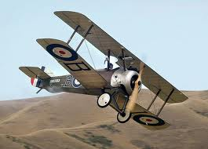
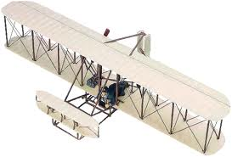
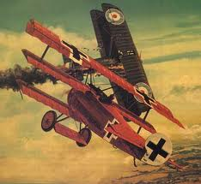

Slide 40
Model Building Grading Rubic
Each Group MUST follow all directions
STOP! - If you are unsure
SAFETY at ALL Times
Accuracy and Authenticity will be judged
Each Group Member is responsible to produce a 2 page paper on the model.
Aircraft Specifications
Aircraft contribution to Aviation development
Significant Aviation Pioneers associated with aircraft (pilots, inventors etc.)
The Group will provide a Presentation on the model.
5to 7 slides (Title slide; Body; Summary Slide)

Slide 41
Questions / Comments

Slide 42
SAFETY FIRST.
SAFETY ALWAYS.

Slide 43
Safety Rules – Safety Monitor Brief
Must Use Safety Glasses
Use of Cutting tools is Dangerous – AT ALL TIMES
Must Use Cutting Mats
Extended breathing of adhesives and paint fumes can be dangerous
All Areas will remain clean and organized
Plane Captains will insure All Areas will be cleaned and all items put back in proper locations 10minutes prior to class ending
Class safety monitor will insure areas are clean and safe at all times

Slide 44
Questions / Comments

Slide 45
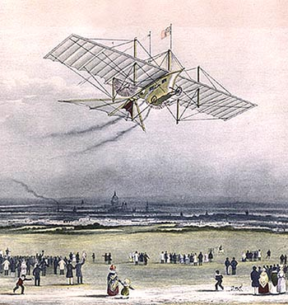
Developing the Airplane
W.S. Henson and John Stringfellow received patent for a man-carrying powered aircraft
Called Ariel
It was never built but a masterpiece of engineering
1848, Stringfellow built a steam-driven model that did fly

Slide 46
Developing the Airplane
W.S. Henson and John Stringfellow received patent for a man-carrying powered aircraft
Called Ariel
It was never built but a masterpiece of engineering
1848, Stringfellow built a steam-driven model that did fly

